Slide 1
Accelerometry Payload
Thursday November 8th, 2019
Gravity Simulation Mission Description
2018-2019 work done
Xavier de Labriolle
(For TOLOSAT use only)

Slide 2
The Basics of Gravimetry with Spherical Harmonics
Accelerometry Payload

Slide 3
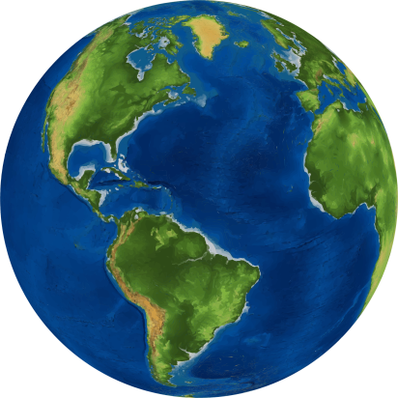
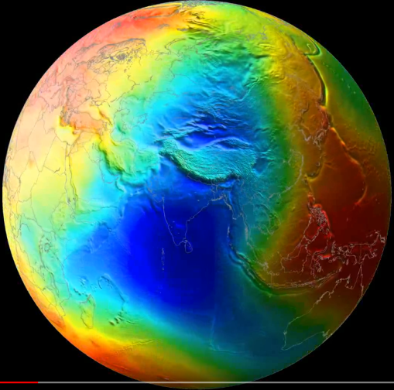
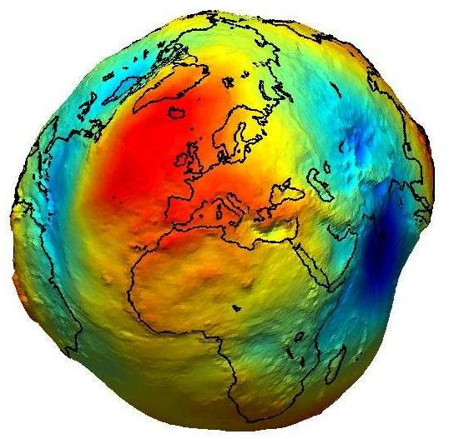


The Basics of Gravimetry
The Issue
The Geoid
Round Earth
Wrong by 44km
+
Sea Level
-
Non-uniform
surface mass
Elipsoid Earth
Accelerometry Payload

Slide 4
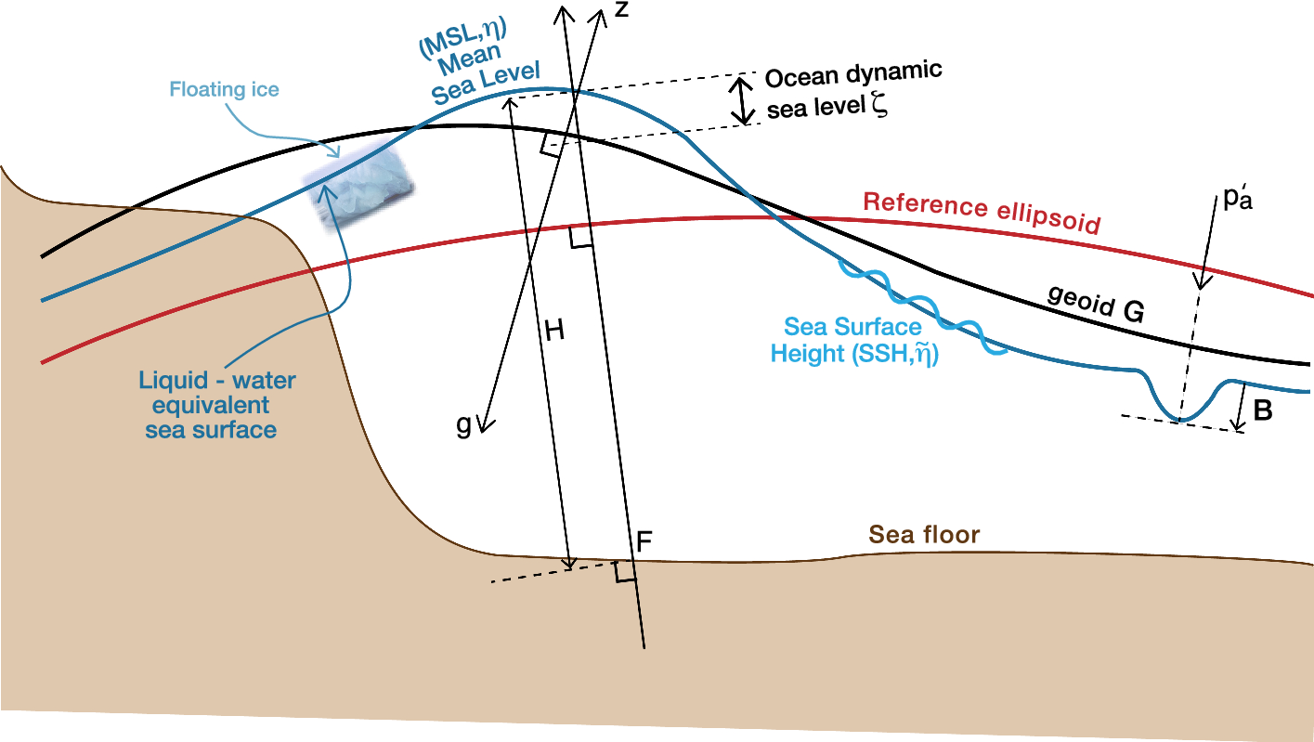
The Basics of Gravimetry
Fig. 2Relationship between surfaces relating to sea level. The normal to the reference ellipsoid defines the vertical in the terrestrial reference frame. The normal to the geoid is the vertical coordinate (z) for geophysical fluid dynamics, and anti-parallel to the local effective acceleration g due to gravity. The difference between these two definitions of the vertical direction is greatly exaggerated in this diagram; it is negligible in reality. The local vertical coordinates of mean sea level ηη, the geoid G and the sea floor FF are relative to the reference ellipsoid, while dynamic sea level ζ~ζ~ is relative to the geoid. The local time-mean thickness of the ocean HH is the vertical distance between mean sea level and the sea floor. The deviation of atmospheric pressure p′apa′ from its global mean causes the depression BB in sea level by the inverse barometer effect
https://link.springer.com/article/10.1007/s10712-019-09525-z
Accelerometry Payload

Slide 5
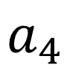
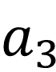







Polynomials ?
$f\left(x\right)= a_{0}+a_{1}x+ a_{2}x^{2}+ a_{3}x^{3}$ $+ a_{4}x^{4}$ $+…+ a_{n}x^{n}$
$$=$$
$$a_{0}$$
$$+$$
$$a_{1}$$
$$+$$
$$a_{3}$$
$$+$$
$$a_{4}$$
Accelerometry Payload

Slide 6
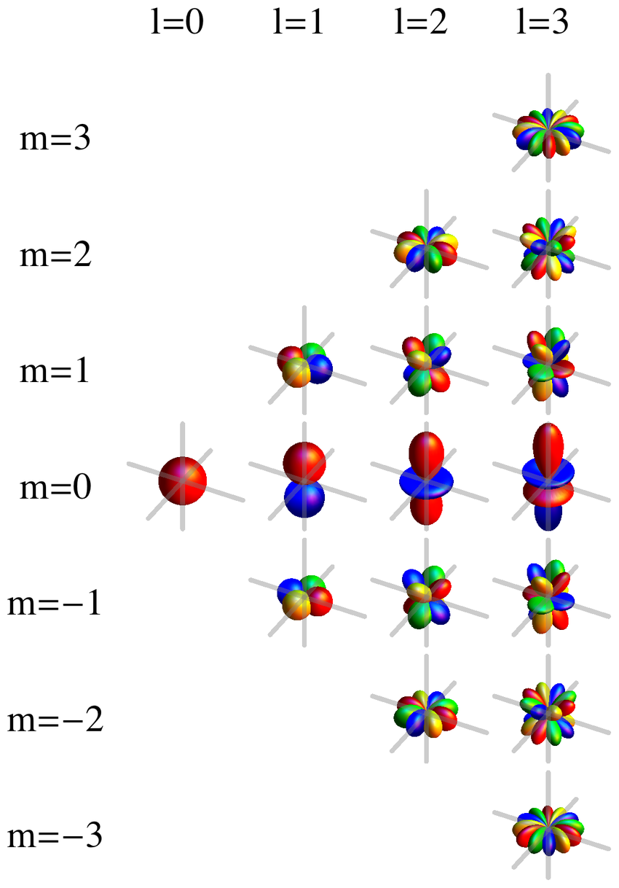
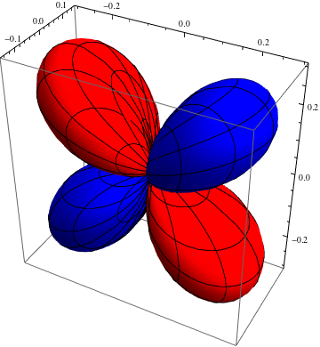
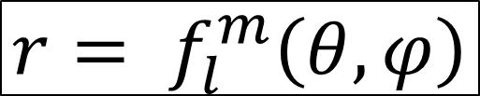
Spherical Harmonics
$$r= f_{l}^{m}\left(θ,φ\right)$$
https://rodluger.github.io/starry/v0.3.0/tutorials/basics1.html
Accelerometry Payload

Slide 7
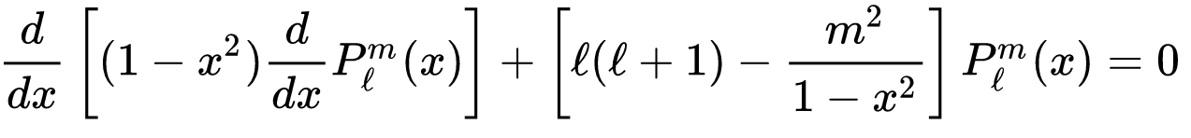
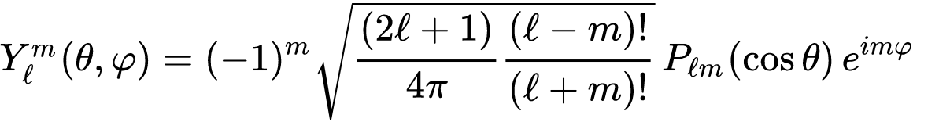
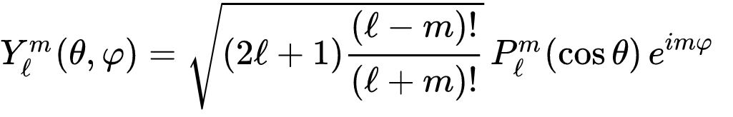
Spherical Harmonics
Legendre Polynomials:
Quantum mechanics:
Geodesy:
https://rodluger.github.io/starry/v0.3.0/tutorials/basics1.html
Accelerometry Payload

Slide 8
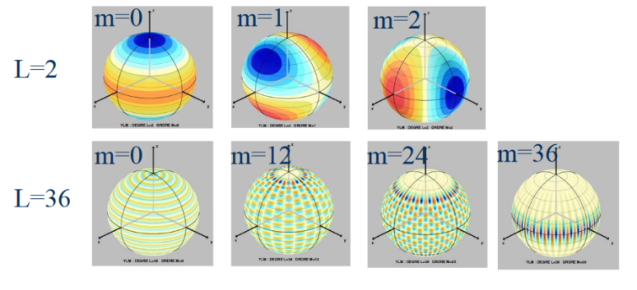
Spherical Harmonics
Accelerometry Payload

Slide 9
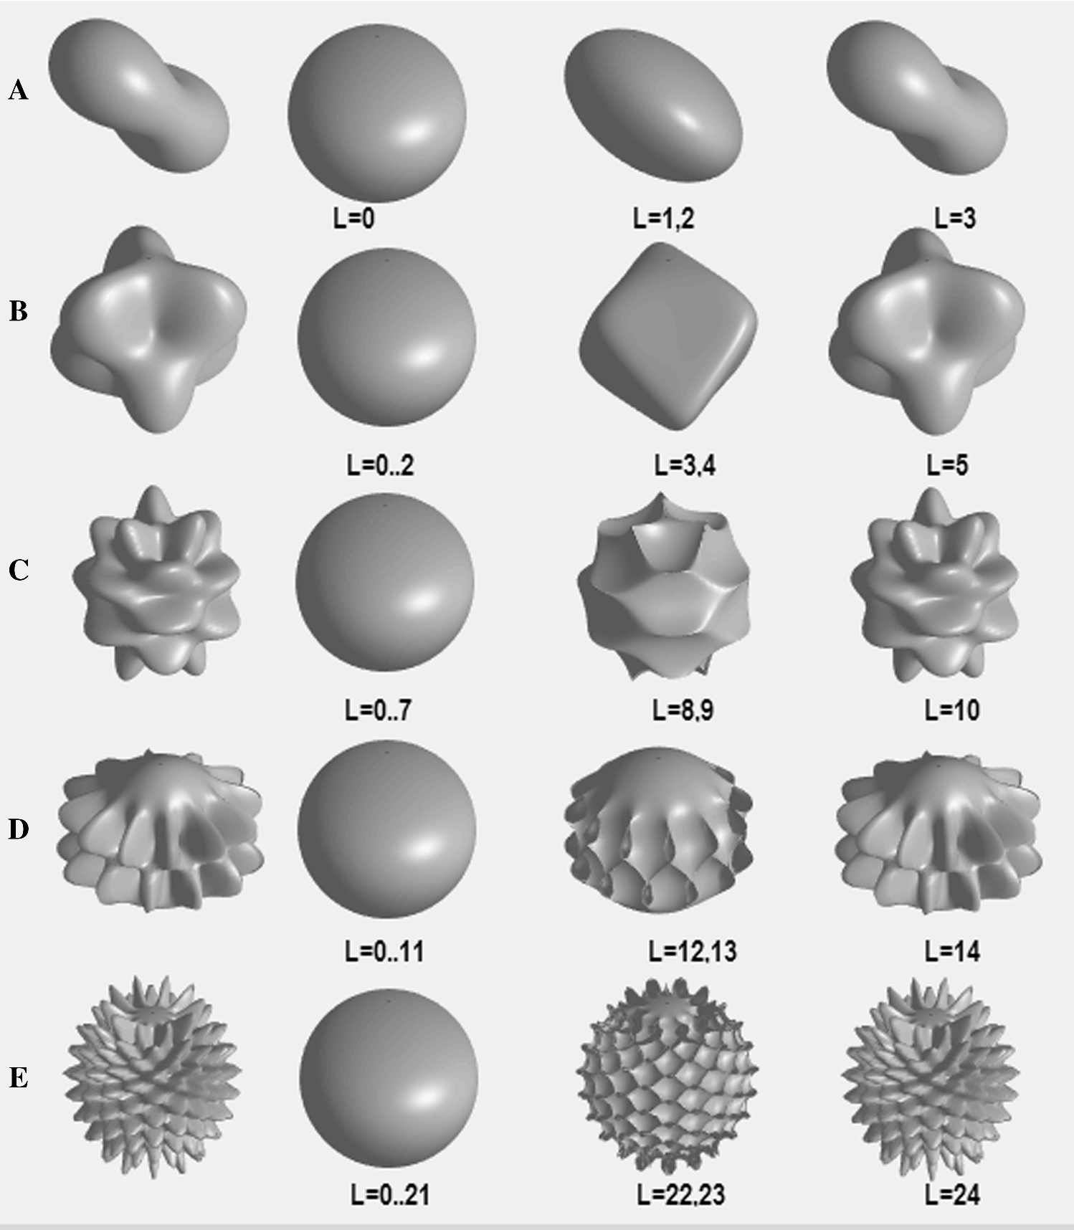
Spherical Harmonics
3D Shape matching
Accelerometry Payload

Slide 10
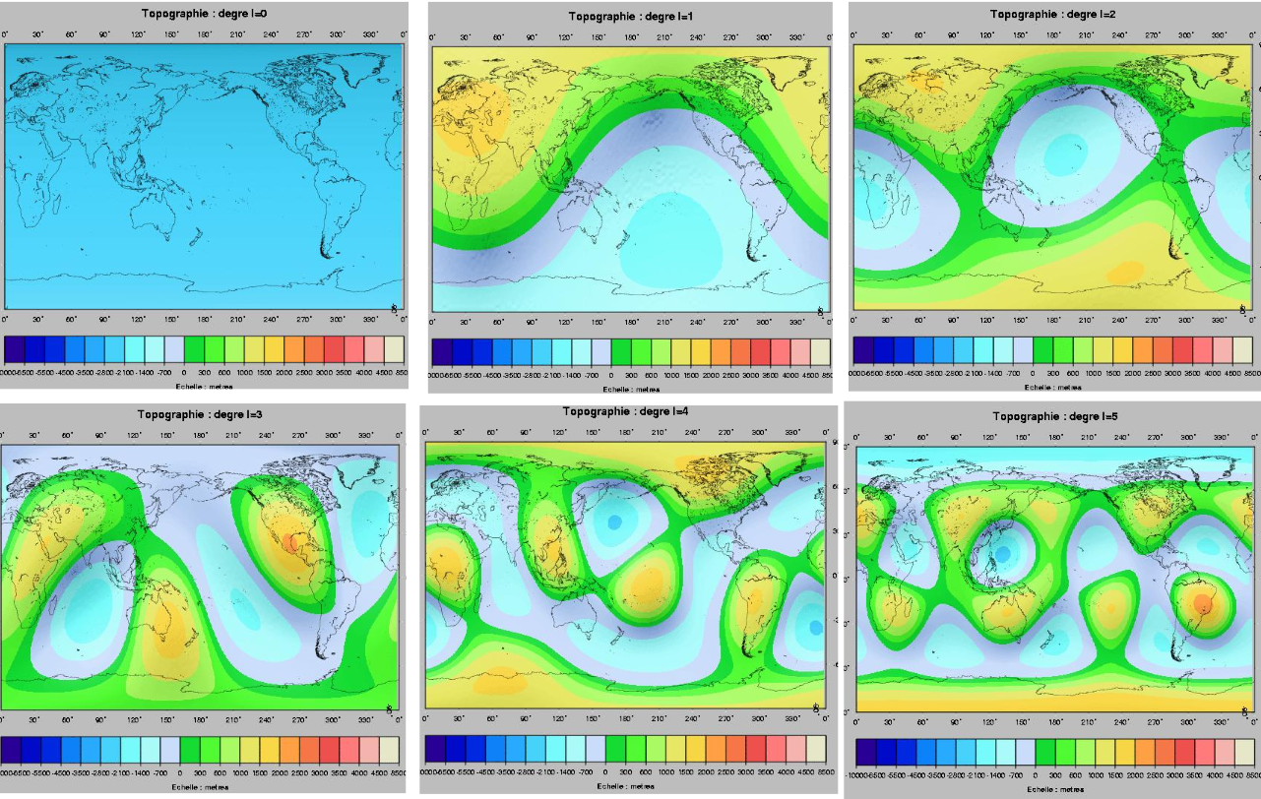
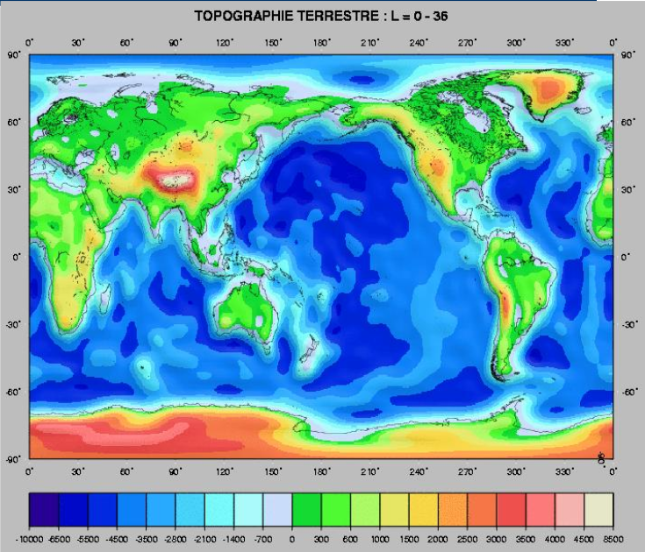
Spherical Harmonics
Accelerometry Payload

Slide 11
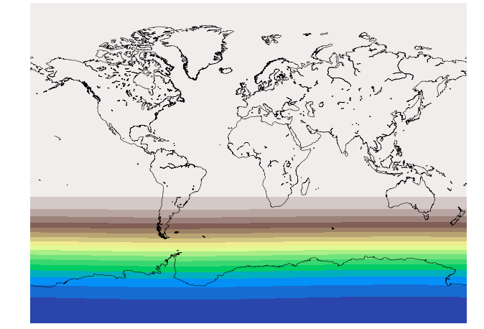
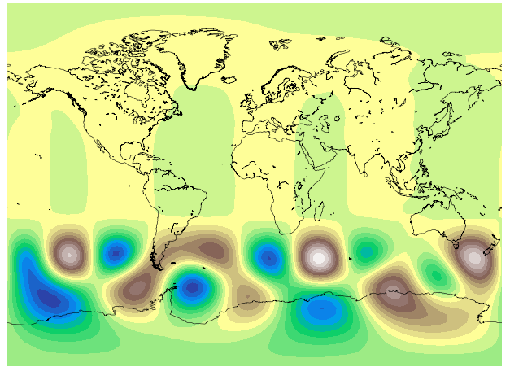
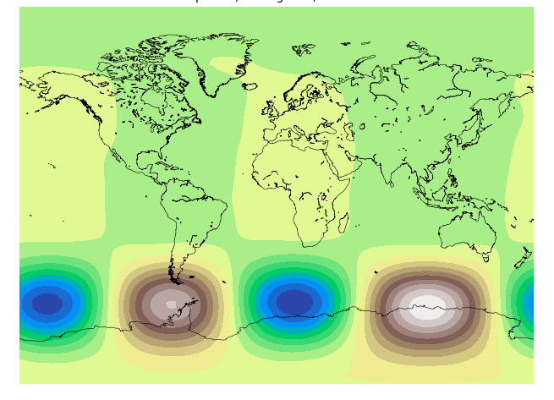
SH – for shits & giggles
Accelerometry Payload

Slide 12
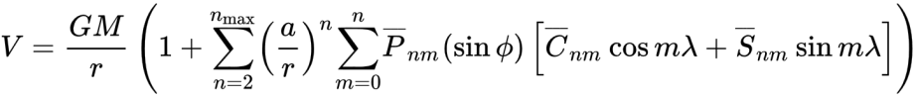
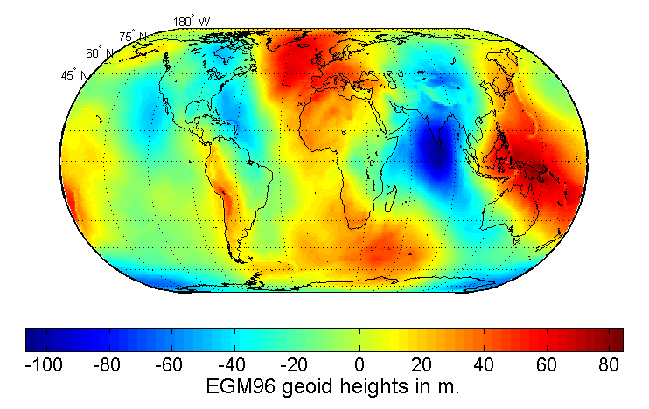
Spherical Harmonics
V(φ,λ)
Accelerometry Payload

Slide 13
Gravity Simulation Mission
Accelerometry Payload

Slide 14

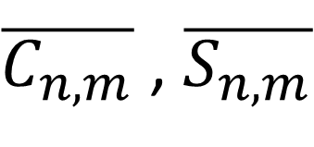
Mission steps
Simulate Earth’s Gravity Field
Generate satellite orbits from the simulated field
Derive the satellite’s acceleration from the generated satellite positions
Solve for SH coefficients of the geoid from the satellite’s acceleration only
Answer mission questions
(X, Y, Z)
$\overline{C_{n,m}}$ , $\overline{S_{n,m}}$
Accelerometry Payload

Slide 15
Mission Questions
Build tools to answer :
What is the spatial resolution we desire for the geoid SH solution?
How do we measure it?
Along the surface (400km?) and in the Geoid height value (5mm?)
How many degrees of SH does that come back to
What sampling frequency to set the receiver at?
How much data will be generated in consequence?
How low must the satellite’s altitude be to obtain the wanted resolution?
How many orbits (or sections of an orbit) will be necessary to obtain the wanted resolution?
How much time does that represent compared to the lifetime of the CubeSat?
How many degrees of SH will be necessary to observe time-variations?
Some extra stuff:
How much does orbit eccentricity affect the results? Polar? ISS?
Is it possible to assess CS acceleration along the transverse axis and the direction axis
Accelerometry Payload

Slide 16
Work Done (as of 08/11/2019)
Accelerometry Payload

Slide 17
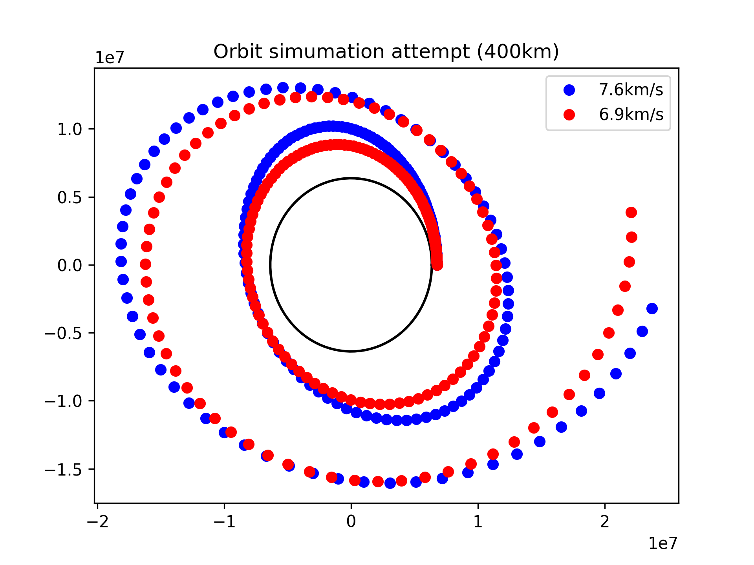

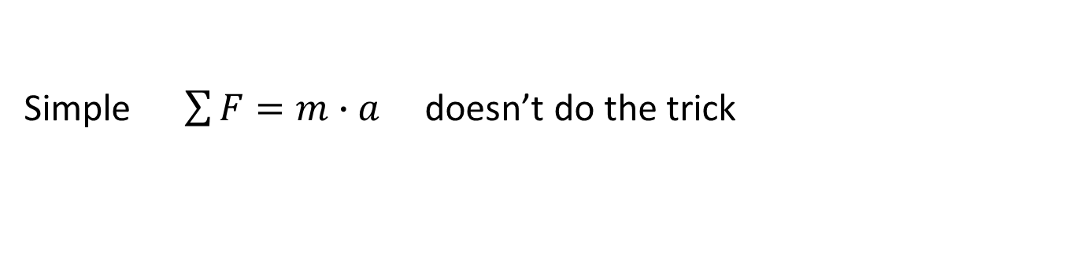
Gravity Simulation
Simple $\sum{F}=m∙a$ doesn’t do the trick
Accelerometry Payload

Slide 18
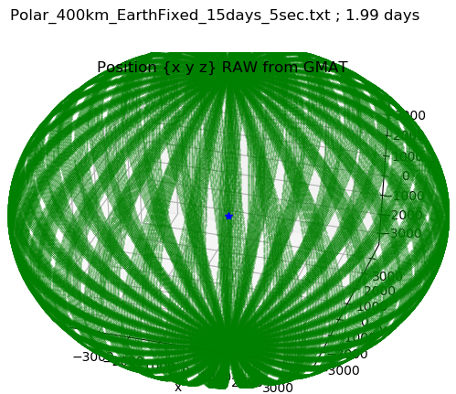
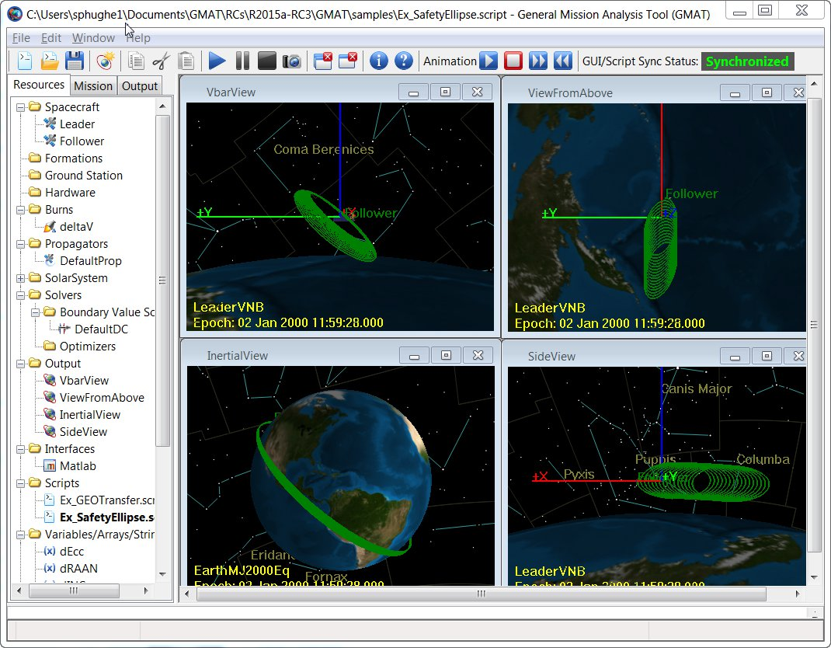
Gravity Sim. steps 1&2
GMAT : General Mission Analysis Tool (NASA)
Generate coordinates of an orbit with NO PERTURBATIONS, JUST EARTH
Python & Matplotlib
Accelerometry Payload

Slide 19
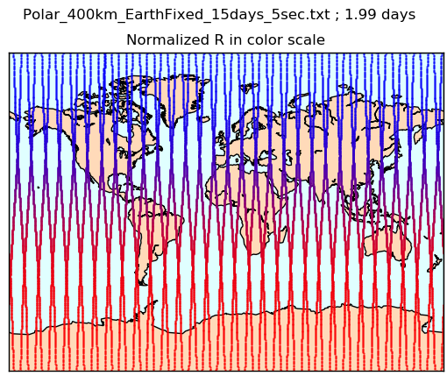
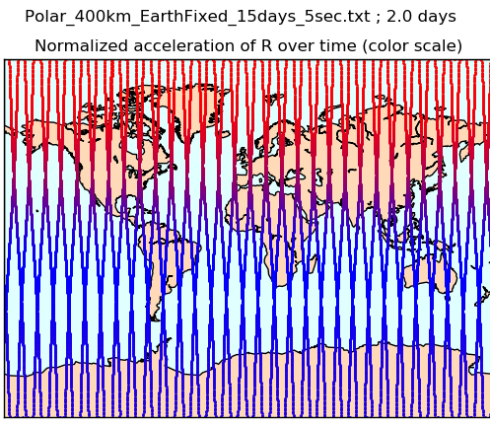
Gravity Sim. step 3
Plotting the coordinates on a map using Python & Basemap library
Accelerometry Payload

Slide 20
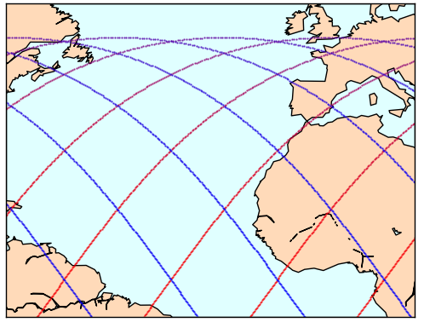
Gravity Sim. step 3
Acceleration depends on the distance to the surface of the Earth
The Equation is complicated
I moved on
Accelerometry Payload

Slide 21
The road to solving for SH coefficients (1)
Simulate Earth’s Topology with downloaded coefficients from EGM96
Extract points from the surface along the path of a satellite
Use said points to solve for the SH coefficients
Compare the Topology generated by the new coefficients
Using Python, scipy, basemap, EGM96
Accelerometry Payload

Slide 22
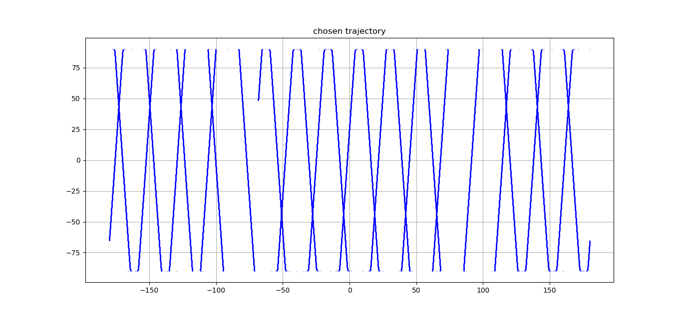
The road to solving for SH coefficients (2)
Simulate Earth’s Topology with downloaded coefficients from EGM96
Extract points from the surface along the path of a satellite
Use said points to solve for the SH coefficients
Compare the Topology generated by the solved coefficients
Accelerometry Payload

Slide 23
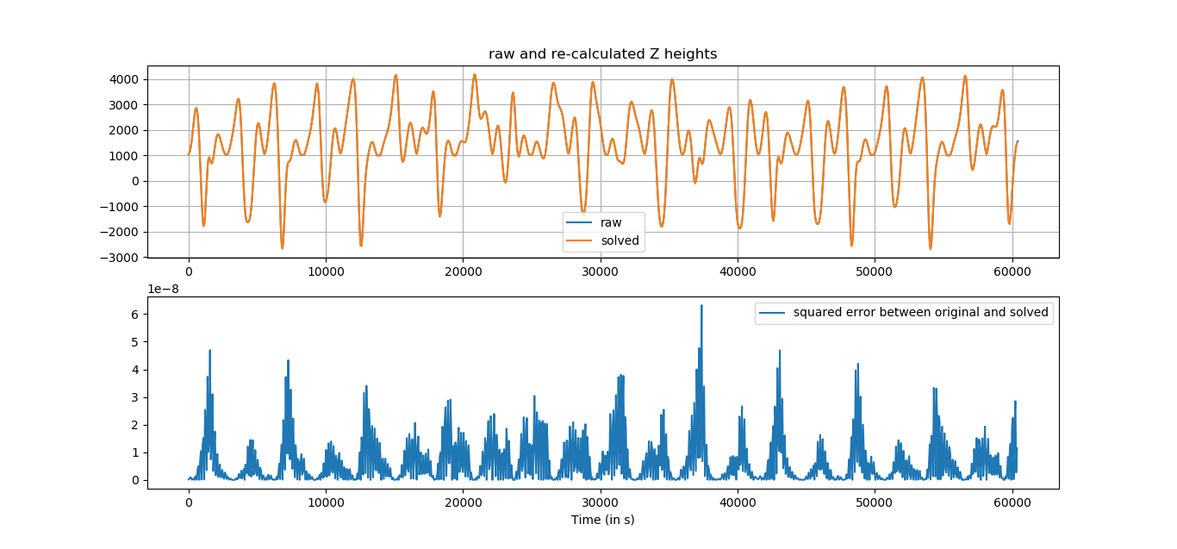
The road to solving for SH coefficients (3)
3. Use said points to solve for the SH coefficients
Solving for
64 coefficients
From 26180 points
Using the least squares method
Accelerometry Payload

Slide 24
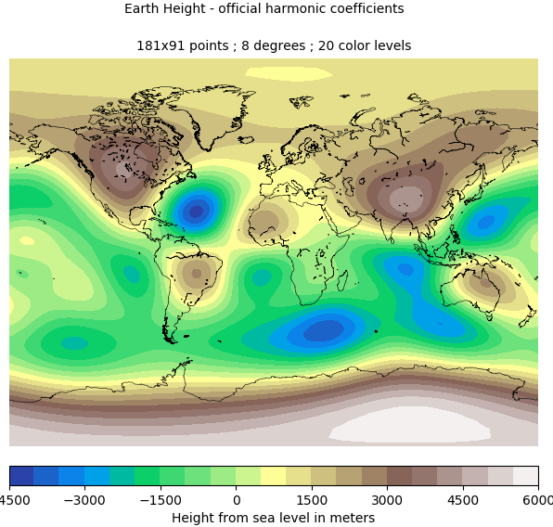

The road to solving for SH coefficients (4)
4. Compare the Topology generated by the solved coefficients
OFFICIAL
SOLVED
3 days worth of orbits,
n = 8 degrees, m = 8 orders
Accelerometry Payload

Slide 25
The road to solving for SH coefficients CONCLUSIONS
The results get wonky beyond n = 8 degrees
Try another method than
Need longer orbits for more points
Topology is not gravity
Compare with actual research
Accelerometry Payload

Slide 26
Accelerometry Payload

